Slide 1

TEAM 2 meNtal health DISORDER
Counselor – Professor Siju Phillip
Course: 24W_CST2106_010 Data Visualization
5 April 2024

Slide 2
Group MEMBERS
Sovanny Sreng -- Team Leader | Data Visualization, Analysis and Interactivity
Hanh Tran | Data Visualization, Analysis and Interactivity
Vasant Dave | Documentation & Data Modeling
Daniel Idogun | Data Cleaning and Preparation

Slide 3
Table of Contents
Introduction
Problem Statement
Objectives
Significance of Data Visualizations
Data Sources
Data Cleaning & Preparation
Data Exploration
Descriptive Analysis
Root Cause Analysis
Analysis using Machine Learning Algorithms
Data Visualizations & Interactivity
References

Slide 4

Introduction
Problem Statement: How is anxiety and depression affecting suicide rates?
What methods are used to deal with mental illness?
Objectives
1)Examine Trends or Patterns of suicide rate
2)Analyze the relationship between suicide rates and indicators of anxiety, depression, or both.
3)How Mental care received is correlated with mental illness and ultimately suicide rates.
4) Disparity regarding treatment (Documentation)
Significance of data visualization
1. Storytelling 3. Decision making
2. Pattern & Trends 4. Accessibility

Slide 5
DATA COLLECTION
Sampling
Sampling in the United States entails selecting a subset that accurately reflects the diversity and characteristics of the entire population.
2.The process of data collection
Step 1: Who – Where – What?
Do some research on the mental health topic to understand who is suffering the most, where is the country or region, what are the consequences, and what are the methods to support.
Step 2: Define the scope
Focus on the mental illness of people at the ages from 18 to 80 in the US between 2000 and 2024, suicide rate which is one of its consequences and possible ways to support people with mental health crisis.
3. Challenges:
Limitation of data availability.
Time consumed in preliminary assessment and discussion

Slide 6






Data Sources
https://data.texas.gov
https://data.ca.gov/
https://catalog.data.gov/dataset/death-rates-for-suicide-by-sex-race-hispanic-origin-and-age-united-states-020c1
https://data.cdc.gov/NCHS/Mental-Health-Care-in-the-Last-4-Weeks/yni7-er2q/data_preview
https://open.gsa.gov/data/
https://www.nih.gov/

Slide 7
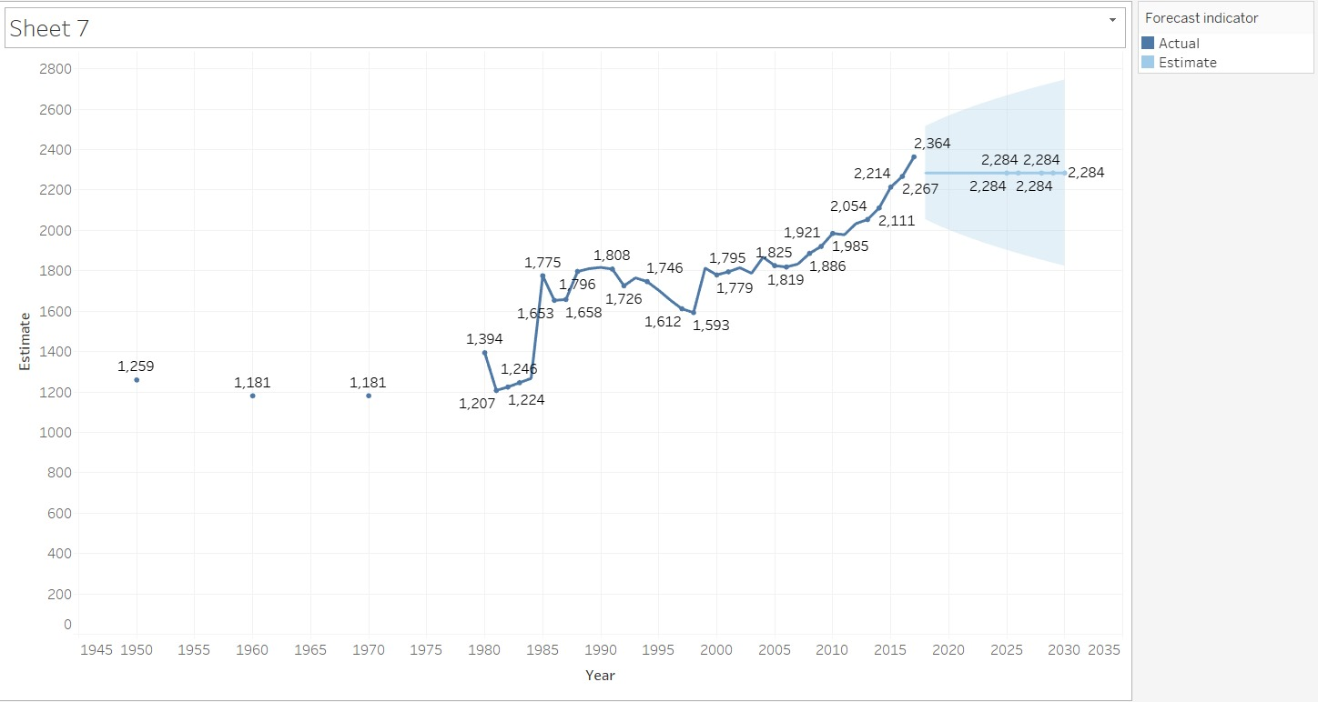
Data exploration
Descriptive Analysis
Provisional CDC data show that the number of suicide deaths in 2022 is the highest recorded, exceeding the next closest year (2018) by over 1,000 deaths .
When adjusted for population growth and age, the suicide rate has risen by 16% from 2011 to 2022, moving from 12.3 to 14.4 deaths per 100,000 individuals

Slide 8
Data ANALYSIS IS NOT JUST ABOUT TAKING THE DATA AND VISUALIZING. IT IS about finding the why’s behind THE DATA
T
QUOTE :-
GUESS!!

Slide 9
Data ANALYSIS IS NOT JUST ABOUT TAKING THE DATA AND VISUALIZING. IT IS about finding the why’s behind THE DATA
T
QUOTE :-
Professor Siju

Slide 10
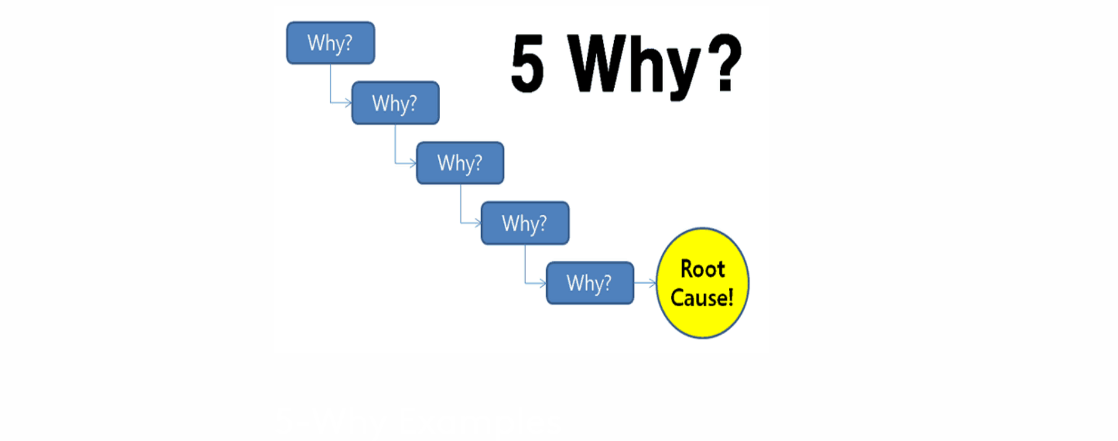
Data exploration
Root Cause Analysis
According to the World Health Organization (WHO), mental illness is a significant risk factor for suicide worldwide. Around 90% of individuals who die by suicide have been diagnosed with a mental illness
According to the National Institute of Mental Health (NIMH), in the United States, about one in six adults reported taking psychiatric medication for mental health conditions such as anxiety, depression, or insomnia in 2019.

Slide 11
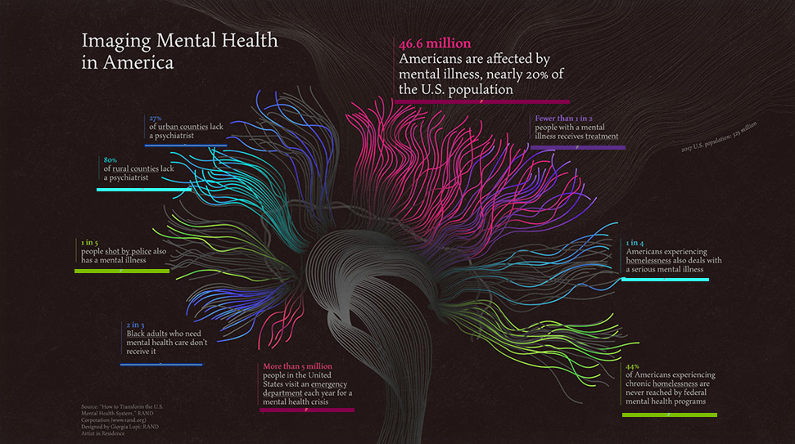
Data exploration
Root Cause Analysis

Slide 12
Data cleaning & preparation
Dataset 1 (Suicide Rates)
Dropped one Column with information not required. (Almost empty)
Replaced missing values with mean for numerical columns
Checked for outlier boxplot for numerical values and count plot for categorical values. (Step stays consistent for All datasets)
Feature Engineered a new column Gender from the existing Stub Label column (Consisting of more than gender related values)
Dataset 2 (Indicators of Anxiety or Depression or both)
Dropped two Columns with missing or null values and information not required.
Imputed necessary column missing values with mean
Dataset 3 (Mental health care Received)
Dropped three Columns with missing or null values
Imputed necessary column missing values with mean
Renamed Row Values for better analysis
Change Columns Data Type
Feature Engineered a new Column Year (Extracting from the existing year range)

Slide 13
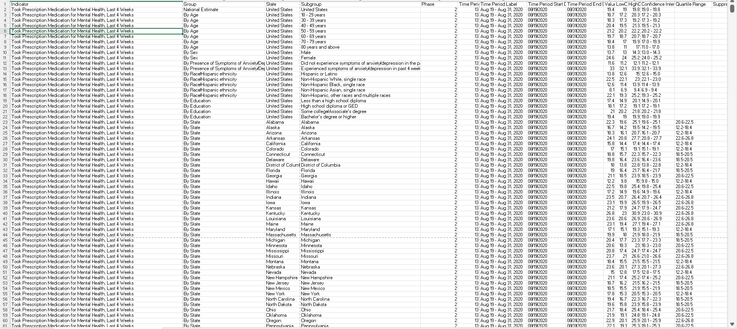
Data cleaning & preparation
Before Cleaning

Slide 14
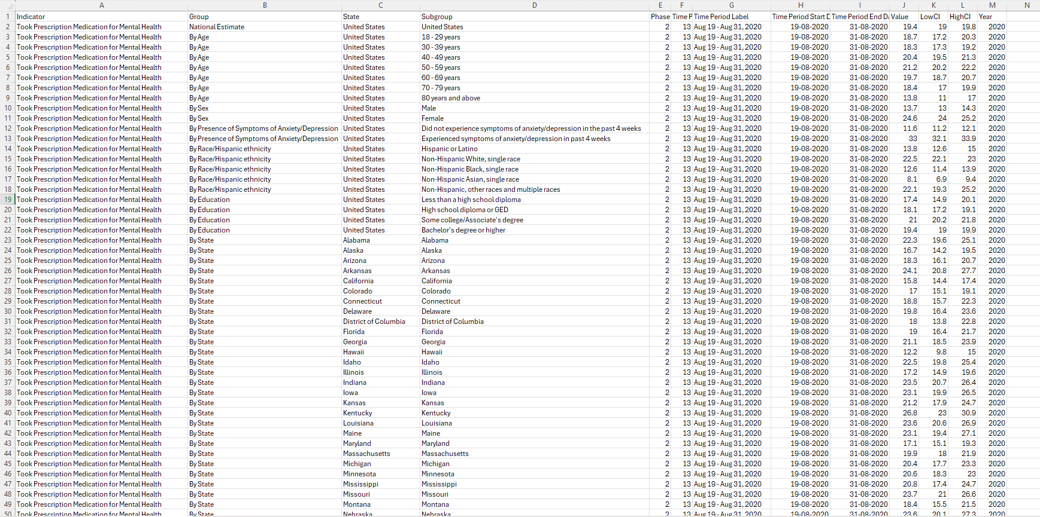
Data cleaning & preparation
After Cleaning

Slide 15
Suicide Rates:
Target Variable: Annual suicide rate (number of suicides per population) for each year.
Objective: Predict future suicide rates for the next three years (2025,2026,2027) based on historical trends and relevant predictors.
Linear Regression
Symptoms of Anxiety or Depression:
Target Variable: Variable indicating whether an individual exhibits symptoms of anxiety or depression (e.g., diagnosed with anxiety or depression disorder).
Objective: Predict the likelihood of an individual experiencing symptoms of anxiety or depression based on demographic, socioeconomic, and other relevant factors.
Logistic Regression
Mental Care Received :
Target Variable: Type of mental care received by individuals (e.g., prescription medication, counseling).
Objective: Predict the type of mental care an individual is likely to receive based on their characteristics, symptoms, and other relevant predictors.
Random Forest (Integrated grid search CV)

Slide 16
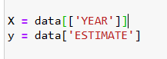
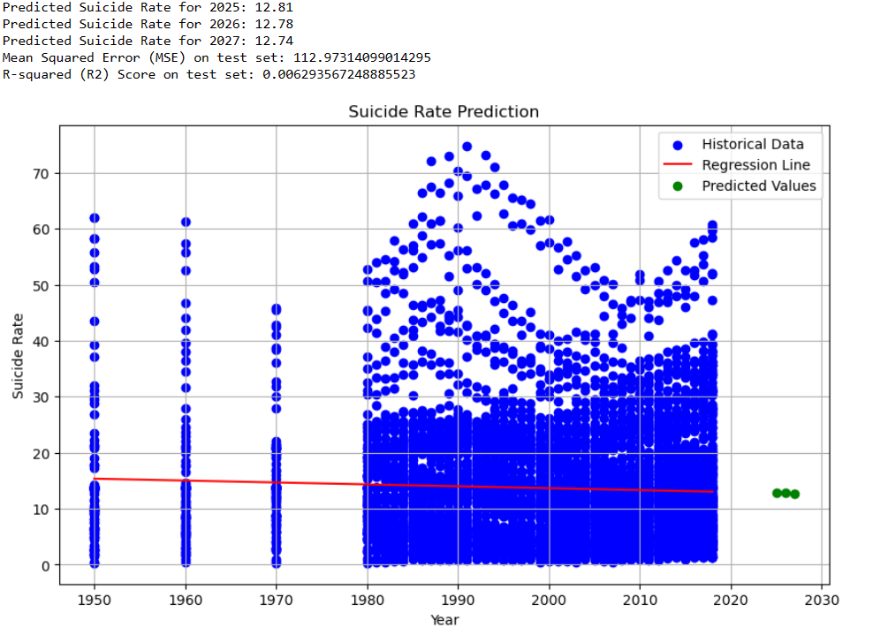
(FAILURE MODEL 1)
Target Variable: Annual suicide rate (number of suicides per population) for each year.
Objective: Predict future suicide rates for the next three years (2025,2026,2027) based on historical trends and relevant predictors.
Bad accuracy
Linear Regression

Slide 17
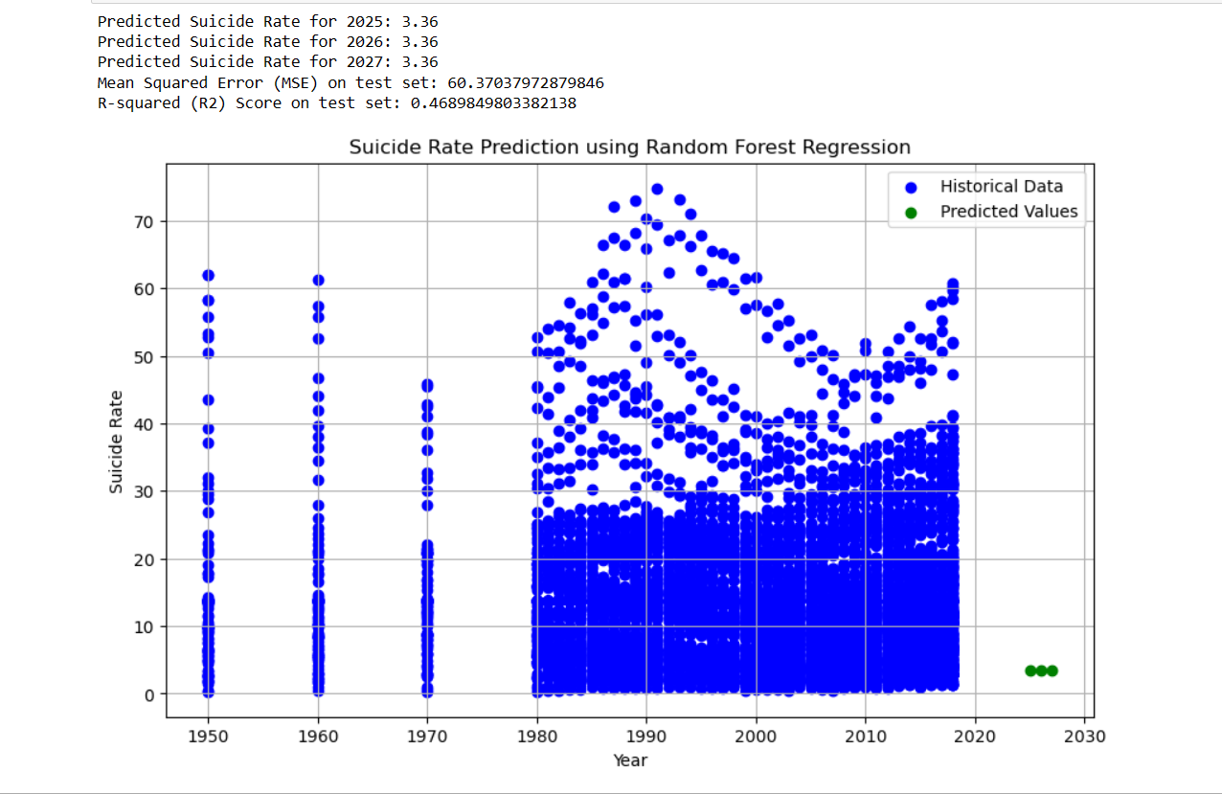
(FAILURE MODEL 1)
Target Variable: Annual suicide rate (number of suicides per population) for each year.
Objective: Predict future suicide rates for the next three years (2025,2026,2027) based on historical trends and relevant predictors.
Wrong predictions
Random forest Regression

Slide 18
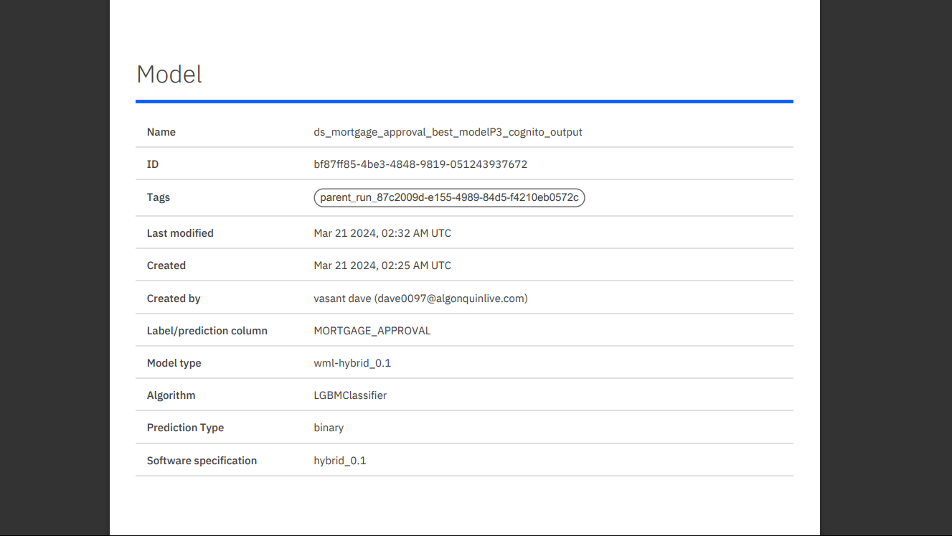

Slide 19
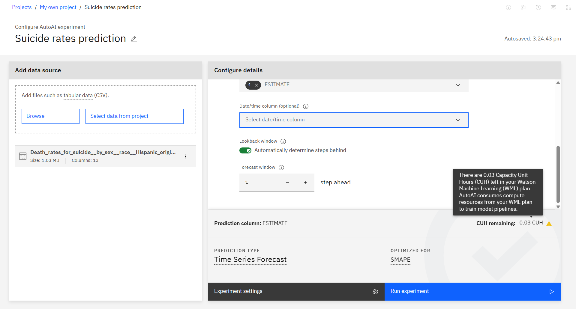

Slide 20
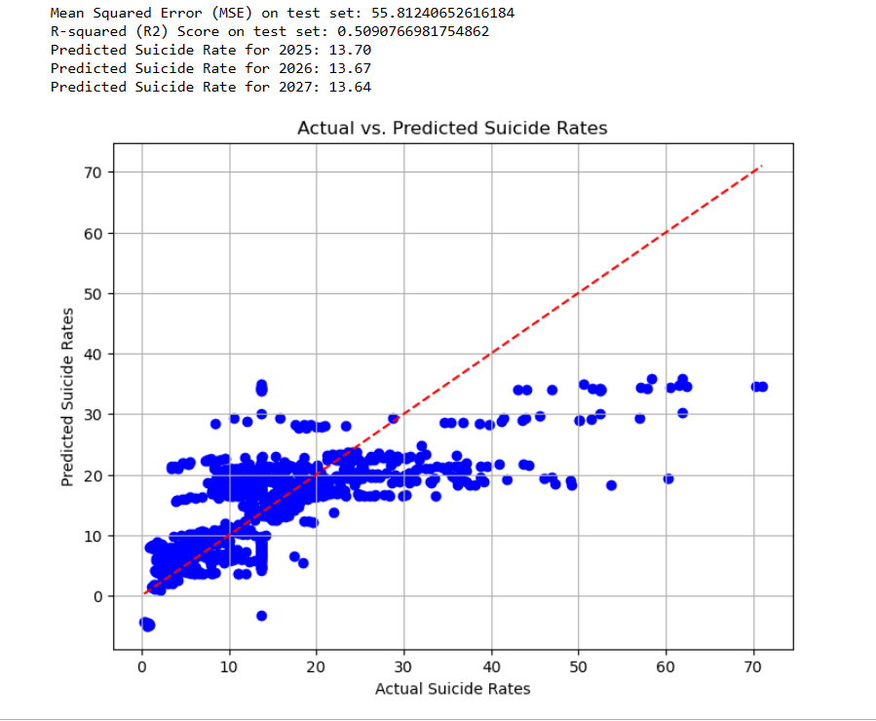
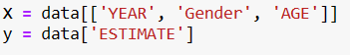
(SUCCESS MODEL 1) Suicide Rates:
Target Variable: Annual suicide rate (number of suicides per population) for each year.
Objective: Predict future suicide rates for the next three years (2025,2026,2027) based on historical trends and relevant predictors.
60% Accuracy
Linear Regression

Slide 21
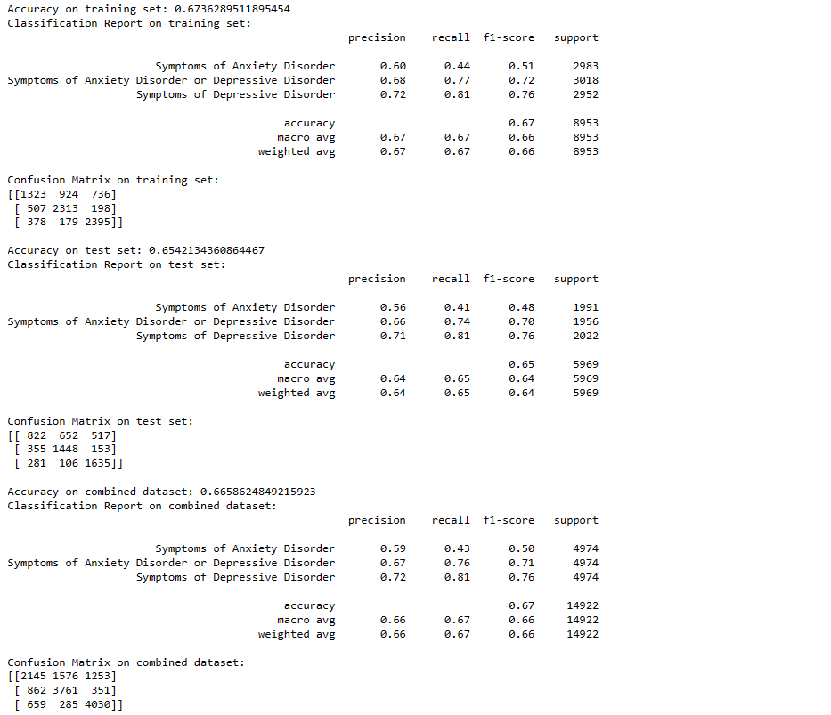
(MODEL 2) Symptoms of Anxiety or Depression:
Target Variable: Variable indicating whether an individual exhibits symptoms of anxiety or depression (e.g., diagnosed with anxiety or depression disorder).
Objective: Predict the likelihood of an individual experiencing symptoms of anxiety or depression based on demographic, socioeconomic, and other relevant factors.
65%-70% Accuracy
Logistic Regression

Slide 22
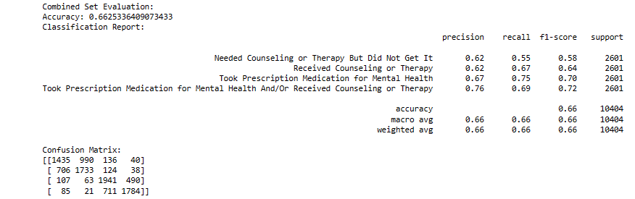
(MODEL 3) Mental Care Received:
Target Variable: Type of mental care received by individuals (e.g., prescription medication, counseling).
Objective: Predict the type of mental care an individual is likely to receive based on their characteristics, symptoms, and other relevant predictors.
60-70% Accuracy
Random Forest

Slide 23
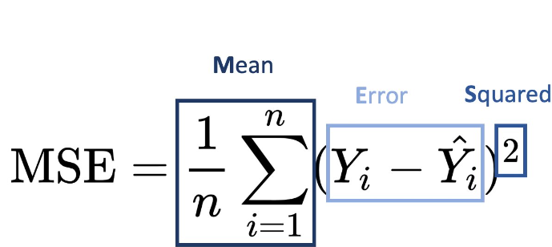
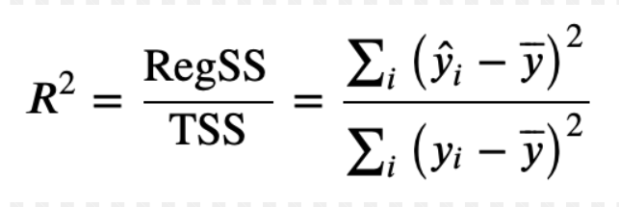
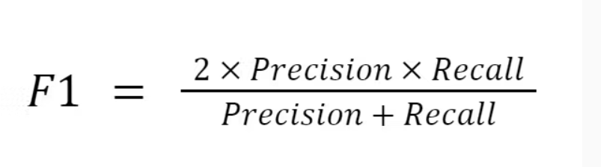
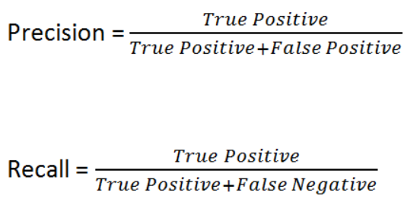
EVALUATION METRICS USED : MSE & R2 SCORE
Rate=dxdy=x' , which means the derivative of x . So, to calculate a rate, you must have two values changing, you fix a time, or any equivalent measure, and calculate their changes, then divide them. Your rate will tell you how the numerator variable changes with the denominator variable
Suicide Rate=
Population
Number of suicides
​×100,000

Slide 24
Data visualization
Tools and techniques Used for Data Visualization
Using Tableau for data visualization
Favorite graphs and charts: lines chart, horizontal & side-by-side bars and stacked bars
2. Demo Visualization
Within 100, 000 resident population of the US,
How is the death rates by suicide
People suffering from depression and anxiety symptoms
How many are choosing what methods to tackle these mental illness: Prescription, therapy or both

Slide 25
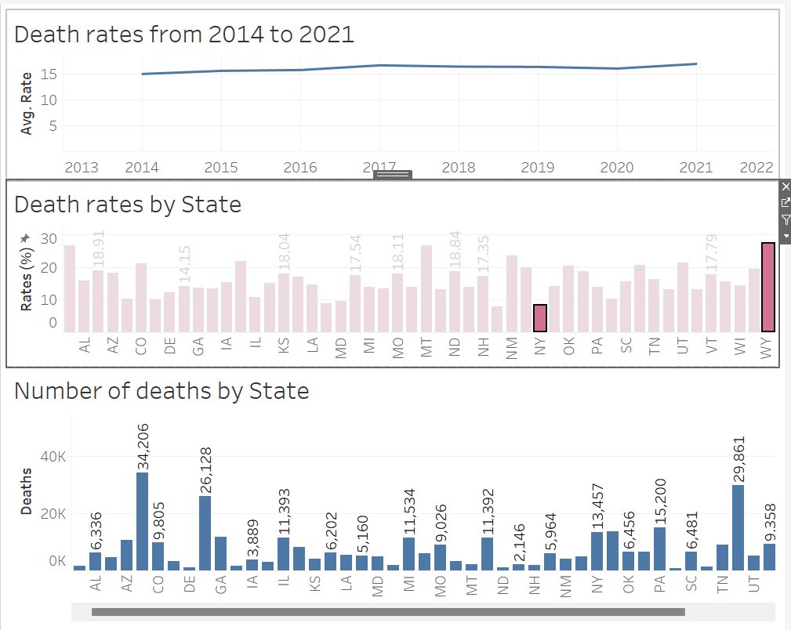
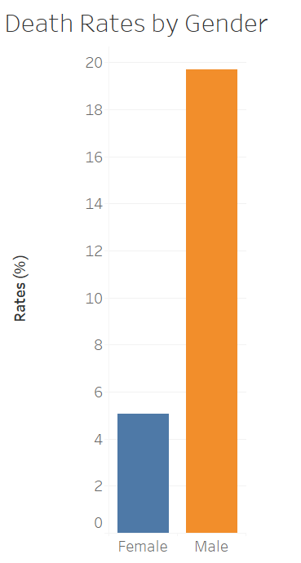
Death rates by suicide

Slide 26
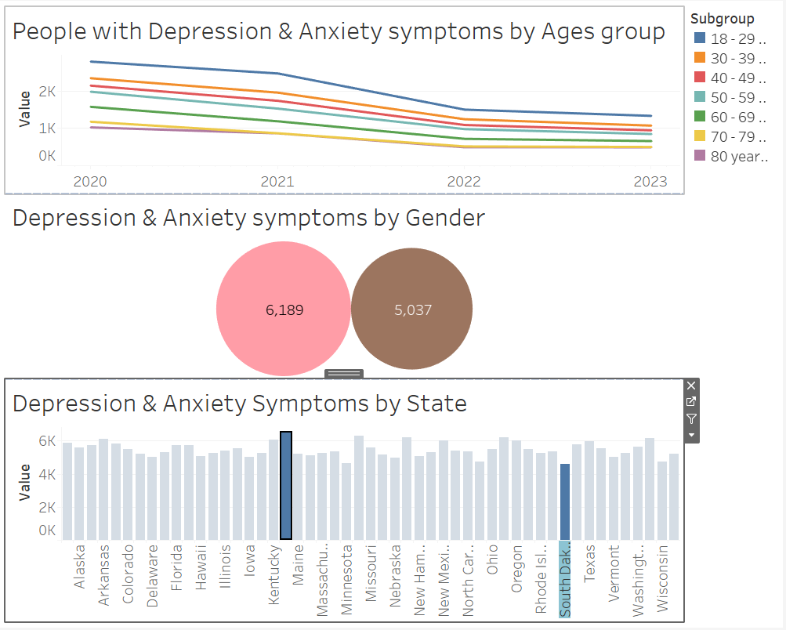
People with symptoms of depression and anxiety

Slide 27
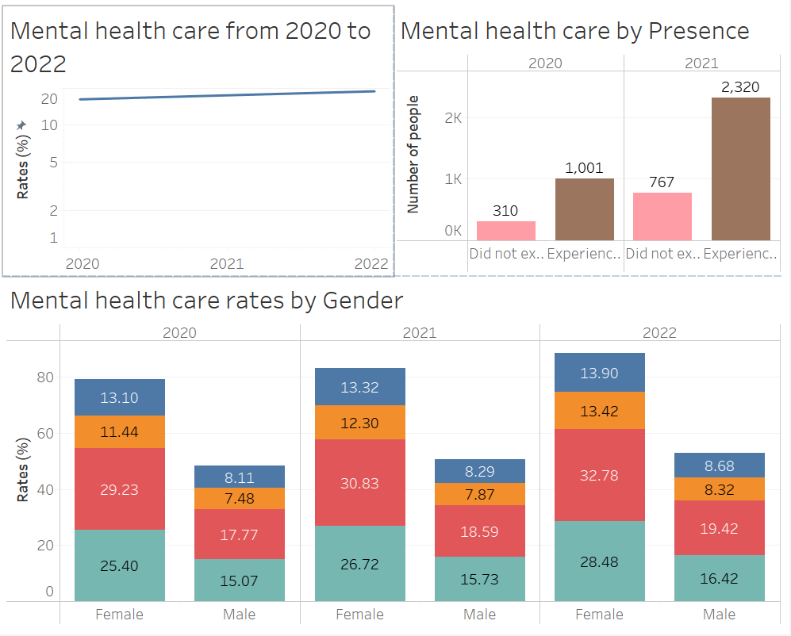
People with or without therapy and prescription

Slide 28
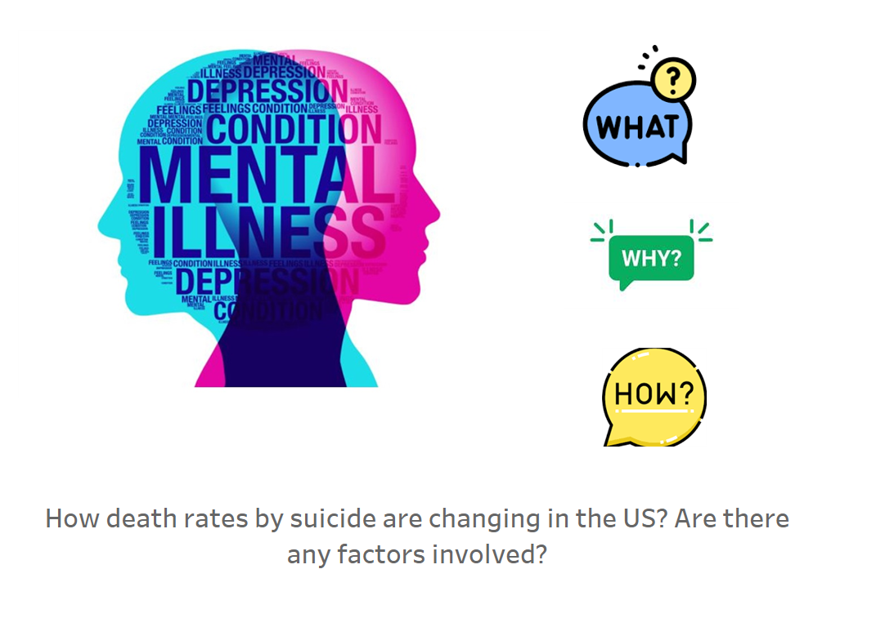
Data Visualization

Slide 29
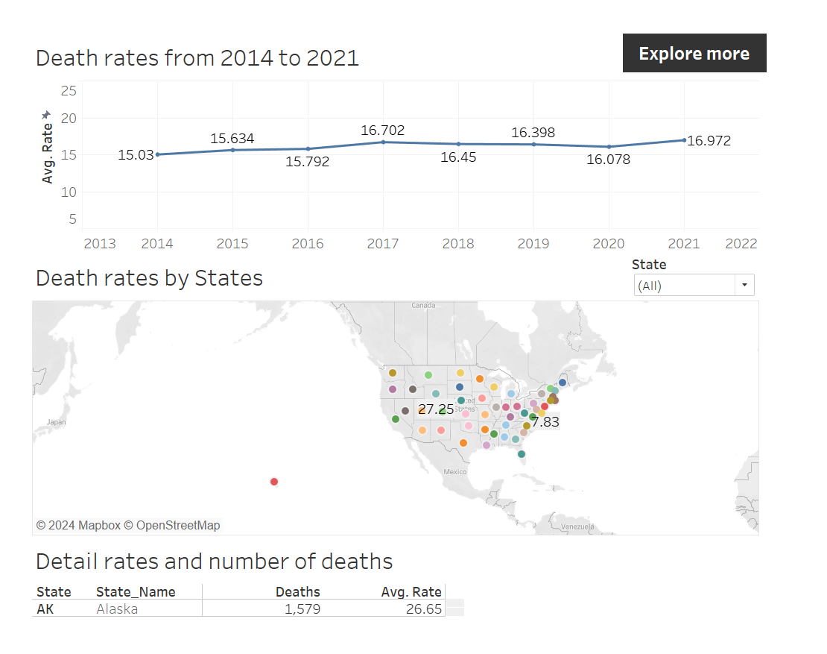
Death rate by suicide in the US experienced an upward trend from 2014 to 2021. The rate was 15.03% in 2014, which was the lowest figure in the period, then increased steadily to 16.70% in 2017. Subsequently, the figure decreased in the next 4 years before reaching the highest rate at nearly 17%, increasing nearly 2% from 2014 to 2021
To get more detail on the rate of each state, looking at the second graph. The state with the highest average rate was Wyoming, 27.25% and the lowest was New Jersey, 7.83% during the period. However, in terms of number of deaths, California was the state which had the highest number, more than 34,000 people. By selecting the value in the filter State, the last chart shows data of the selected state accordingly.

Slide 30
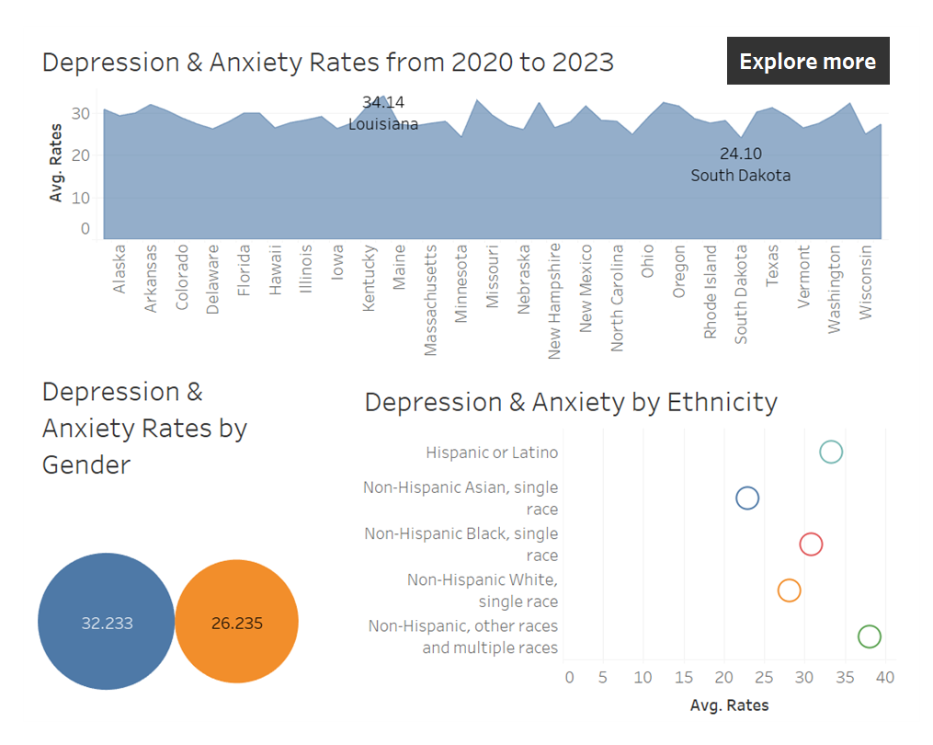
There were many people getting depression and anxiety symptoms in all sates of the US. Louisiana was the state with highest figure, 34.24%, while South Dakota was the lowest, 24.10% over a period of 4 years, from 2020 to 2023.
When looking at ethnicity groups, Non-Hispanic Asian witnessed the lowest rate, about 23%, whereas Non-Hispanic other races and multiple races were nearly double, 40%.
By gender view, more females got depression and anxiety than males, 32.23% and 26.23% respectively.

Slide 31
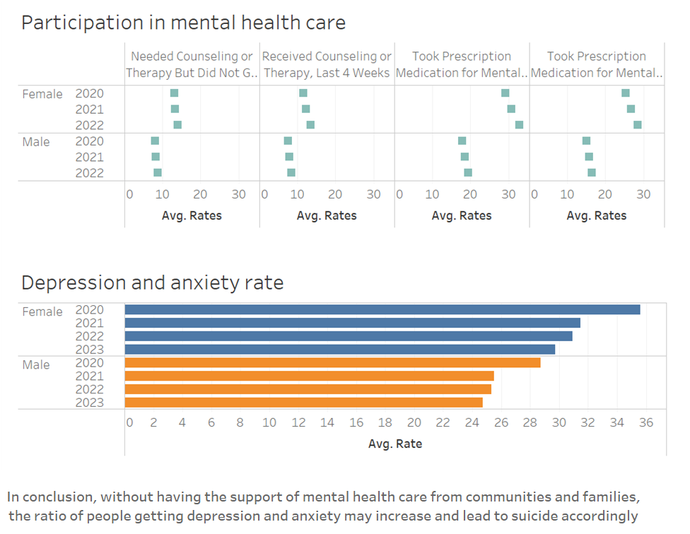
Number of people participated in mental health care increased steadily from 2020 to 2022 for both males and females. The proportion of people took prescription medication and/or therapy/counseling was the highest rate, around 30% for females and around 20% for males.
As a result, the rates of depression and anxiety declined for both females and males during the period. It decreased 6% for females and 4% for males.

Slide 32
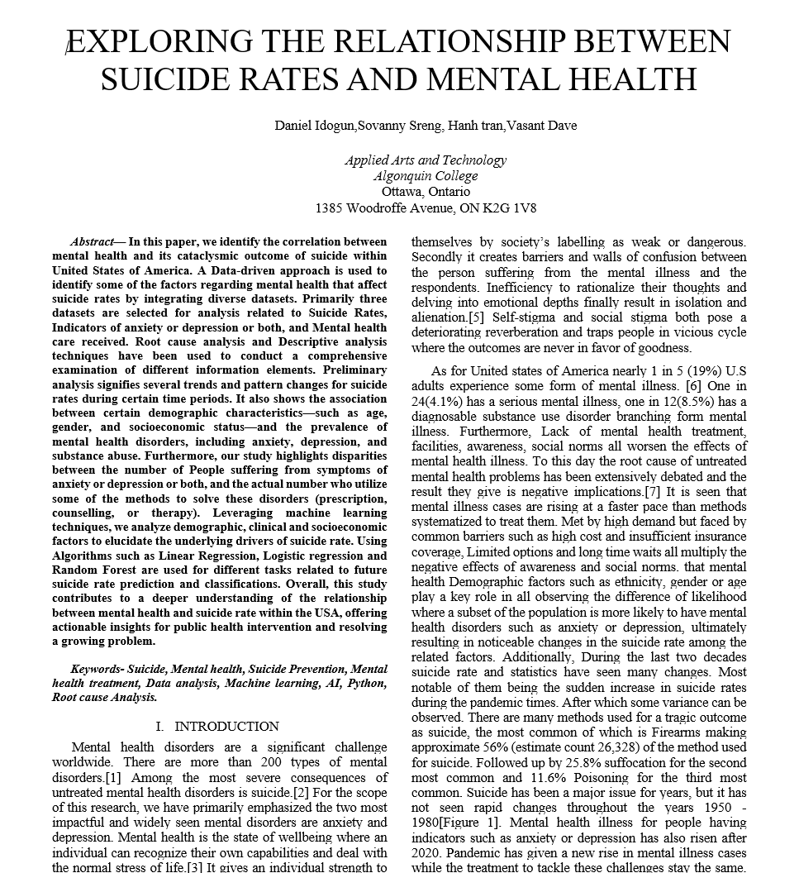

Slide 33
REFERENCES
Data | GSA Open Technology. (n.d.). https://open.gsa.gov/data/
Death rates for suicide, by sex, race, Hispanic origin, and age: United States - Catalog. (2022, April 28). https://catalog.data.gov/dataset/death-rates-for-suicide-by-sex-race-hispanic-origin-and-age-united-states-020c1
Mental health care in the last 4 weeks | Data | Centers for Disease Control and Prevention. (2022, November 28). https://data.cdc.gov/NCHS/Mental-Health-Care-in-the-Last-4-Weeks/yni7-er2q/data_preview
State of Texas | Open Data Portal | Open Data Portal. (n.d.). State of Texas Open Data Portal. https://data.texas.gov
Welcome - California Open data. (n.d.). https://data.ca.gov/

Slide 34


Slide 35


